Slide 1
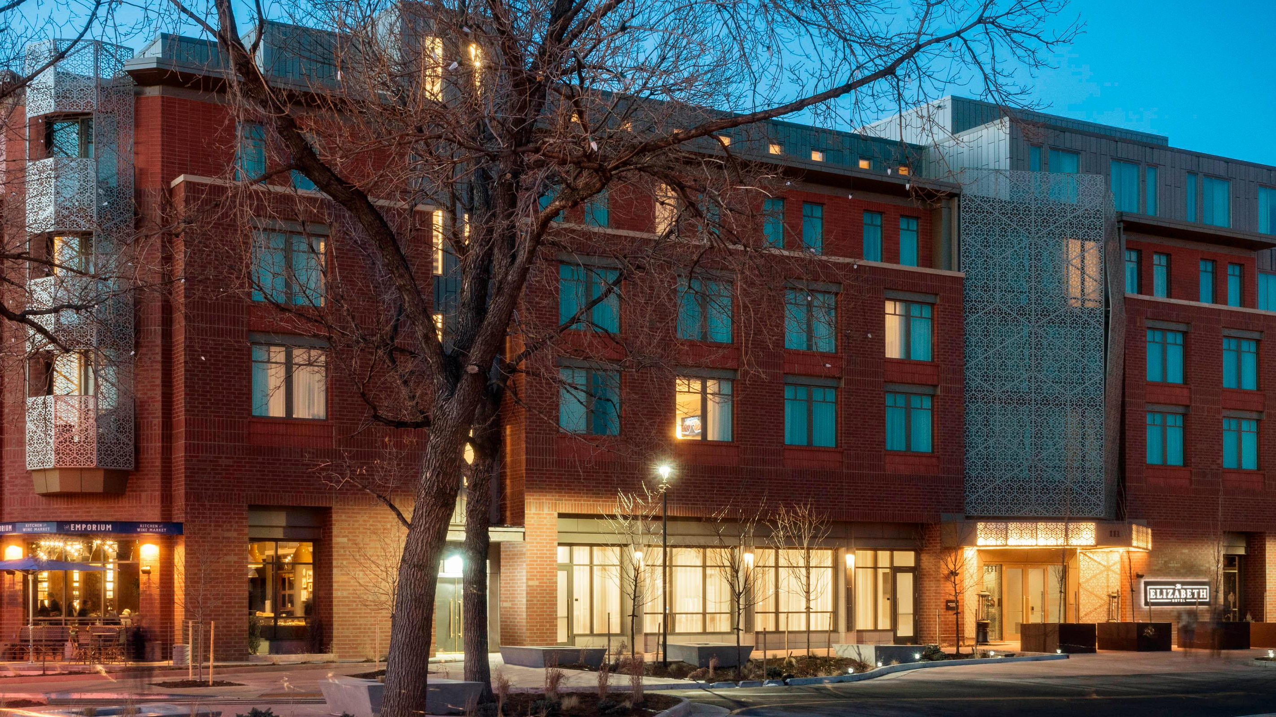
Necessity of Data Security at The Elizabeth Hotel
Ryan Griffin

Slide 2
Introduction
Data security no longer only needed to be considered by legal teams
The Elizabeth Hotel needs to consider investing in data security
62% of small-medium sized businesses are affected by attacks
Purpose – investigate necessity of robust vs. inexpensive security system

Slide 3
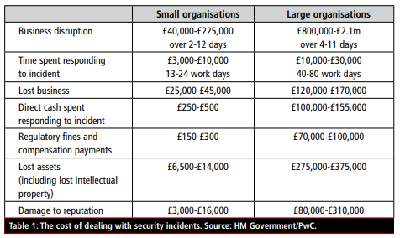
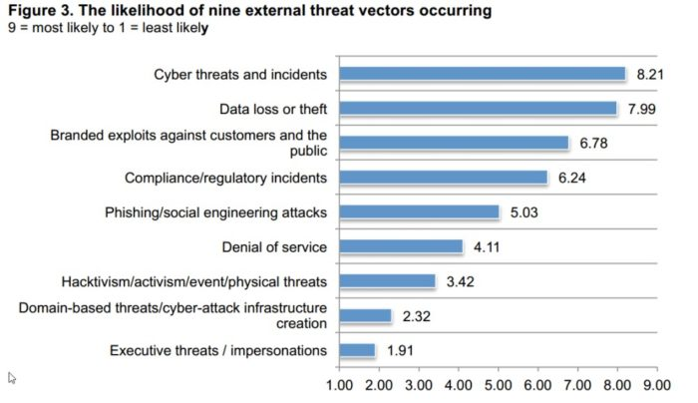
Robust Security
Table: Cost of data breach Incident (HM Government/PwC, 2015)
Robust Security Approach
Ransomware/Email Fraud
Large amount of money lost this way
Human factor involved most of the time. (95%)
Potential losses
Reputation
People stop buying at websites that are breached
Regulations
Figure: The likelihood of nine external threat vectors occurring (CCSI, 2019)

Slide 4
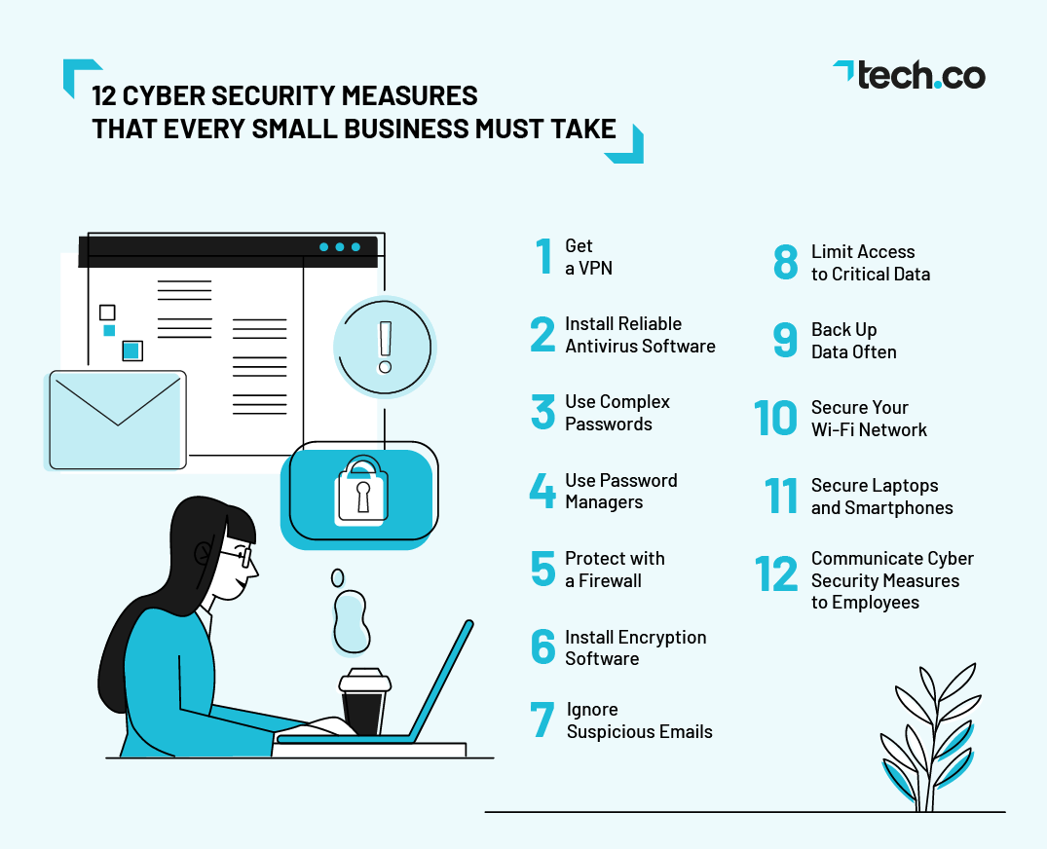
Inexpensive Security
Inexpensive Security Approach
Costs and Savings
Chances of Data Breaches
Employee Equipment Software purchases
Anti-Virus
Two-Factor
Rowe, A. (2021, September 3). 12 cyber security measures that every small business must take in 2021. Tech.co. Retrieved December 3, 2021, from https://tech.co/vpn/cyber-security-measures.

Slide 5

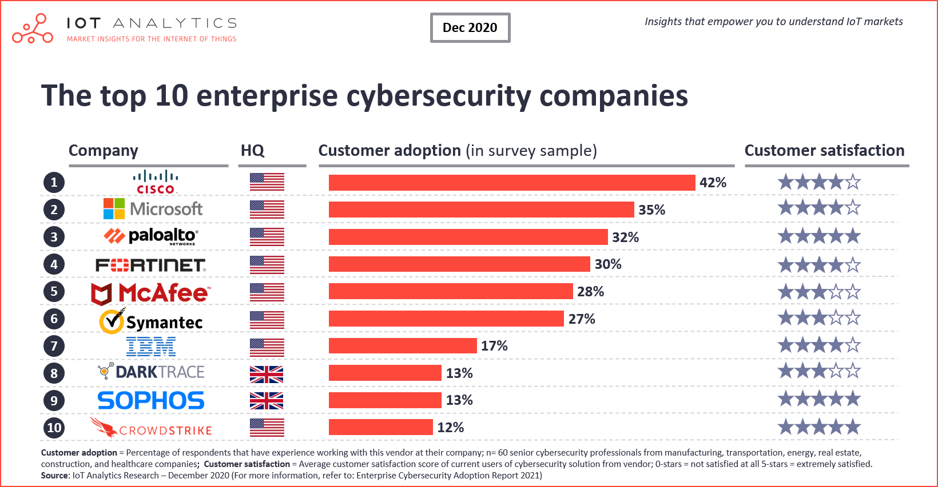
Recommendation
Hire outside company such as CISCO for data security purposes
OR hire own set of data security engineers
Two-factor along with employee lockdown applications
Training course so human component in breach is minimized
Monitor employees (maybe?)
The leading enterprise cybersecurity companies 2021. IoT Analytics. (2020, December 15). Retrieved December 3, 2021, from https://iot-analytics.com/leading-enterprise-cybersecurity-companies-2021/.

Slide 6
Conclusion
Chances are high enough of a breach that Robust should be implemented
Savings do not outweigh the ramifications of having a breach
Reputation sinks if breach does happen

